Slide 1



Be Kind…
Vassiliadis Elementary School is teaming up with the Josh Stevens Foundation again to be a proud Be Kind school!
Notes:
- Echo or choral read the words Be Kind… tell students when we put those words into action, we make our school an awesome place to be.
- Read the rest of the slide.

Slide 2
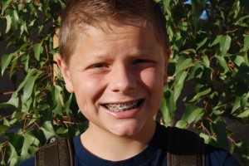
Josh’s Story
Josh went about doing kind things like holding the mall door open for people, carrying bags for people to their car & encouraging teammates who messed up. It wasn’t because he was asked to, or that he thought someone was watching, or that he wanted something in return…it was because Josh was just kind. One month before Josh’s 13th birthday, he lost his life. His time on earth was much too short – but his kind heart and spirit will live forever. Josh’s acts of kindness are still inspiring us all. The Josh Stevens Foundation was created to honor his life and encourage us to Be Kind…Kind like Josh.
Notes:
Read the slide.

Slide 3

Josh’s Legacy
Although Josh is no longer around, his legacy of kindness continues on.
The Josh Stevens Foundation has teamed up with more than 350 schools in 10 states.
He even has a CCSD school named after him – Josh Stevens Elementary!!!
Notes:
Before reading the slide, have students guess the number of schools the Josh Stevens is part of. Discuss the meaning of legacy and ask kids how they would like to be remembered.

Slide 4
BELIEF
Genuine kindness born in the heart of a child deserves celebration.
MISSION
To recognize and celebrate a child's heartfelt kind acts, and to inspire more children to be more kind, more often.
Notes:
Have students echo or choral read the belief & mission of the Josh Stevens Foundation.

Slide 5


Celebrating Genuine Kindness
The Vassiliadis staff would like to recognize and celebrate genuine acts of kindness shown by YOU, our SUPER students!
We want to inspire more kindness, more often at Vassiliadis and encourage ALL of us to be SUPER LEADERS by showing our SUPERPOWER of being SUPER KIND!
Notes:
Read the slide.

Slide 6
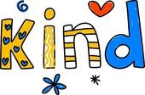
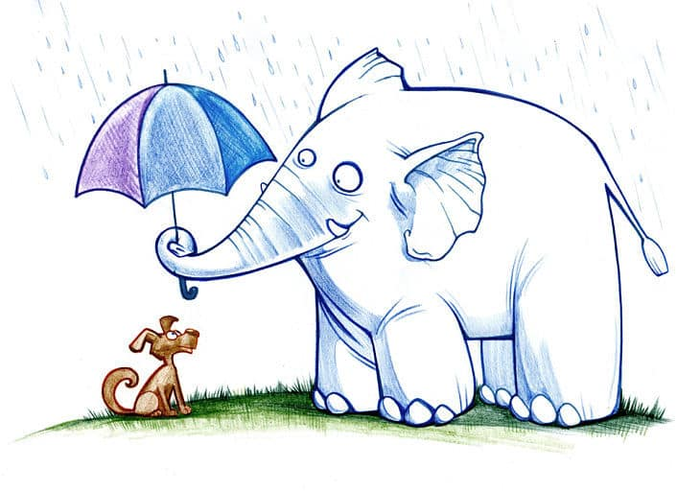
Why Be ???
Most importantly…
Makes others feel good!
Helps create a positive learning environment!
Makes Vassiliadis, Las Vegas & the world a better place!
A feeling of happiness!
A positive memory for YOU!
Inspires more kindness!
On top of that…
Notes:
Show only the title first…Ask students, “Why Be Kind?”
Have a few students share their ideas, then show the rest of the slide

Slide 7
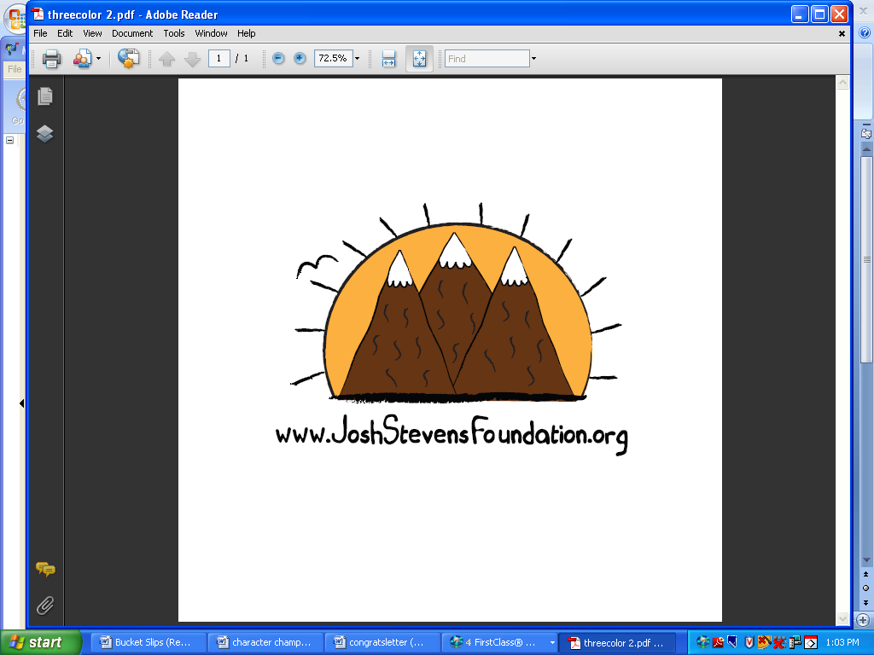
Caught Being Kind…
Leaders who are caught being kind above and beyond what we normally see, will be given a logo card, congrats letter for home and…
Notes:
- Before reading the slide, say, “Our staff is going to be on the lookout for acts of kindness because we want to “catch” kids being kind. We’re looking for kids who are kind like Josh – doing kind things just because they want to be kind and not expecting anything in return.”
- Read the slide.

Slide 8
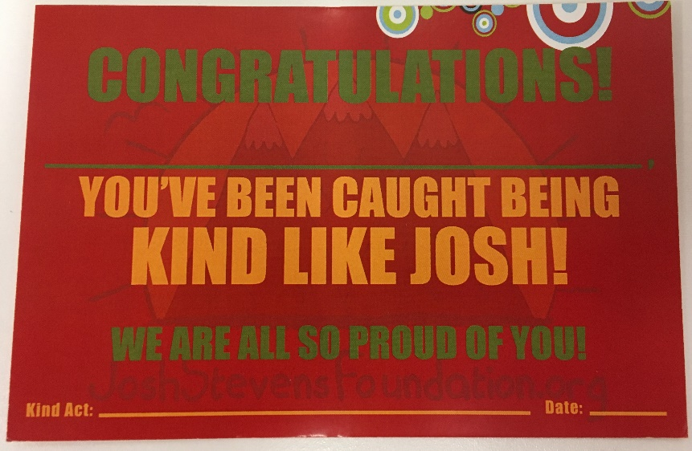
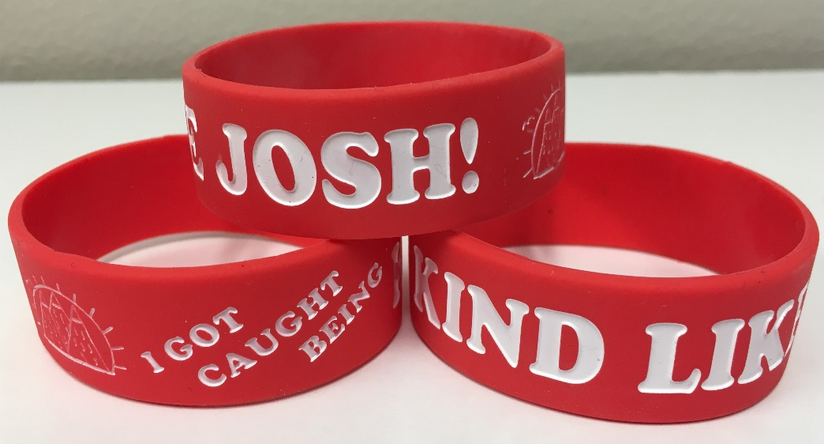


Caught Being Kind…
The Kindness Card, along with…
a Be Kind bracelet and…
a Be Kind shout out on afternoon announcements and your picture on the Be Kind bulletin board!
Notes:
Tell students they will receive the official Josh Stevens Caught Being Kind card, along with a Be Kind bracelet – the kindness gift, be recognized on afternoon announcements, and with their picture on a bulletin board.

Slide 9
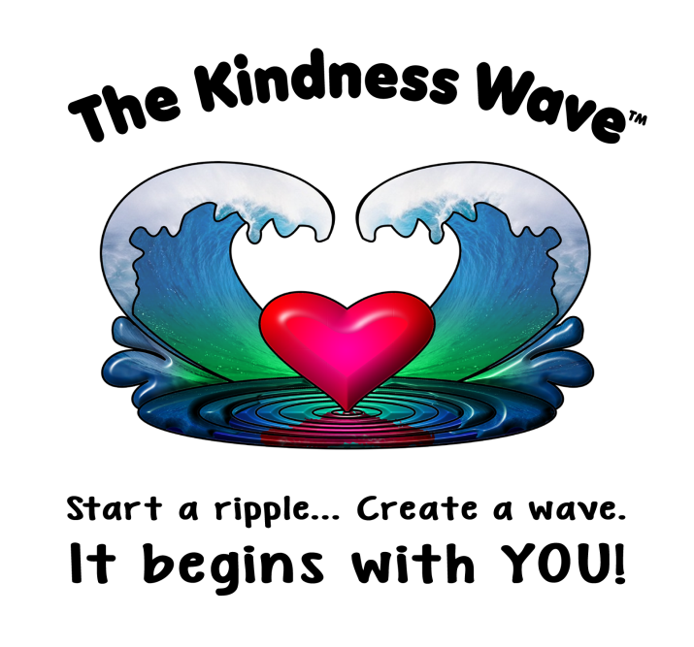
Becoming a True Be Kind School…
Doing kind things just to be kind and not wanting anything in return.
Not caring if a kind act is caught because you know the kindness you showed made someone’s day better.
Inspiring kindness in others…Kindness is contagious!
Notes:
Show only the title first…Ask students, “How can we become a true Be Kind school?”
Have a few students share their ideas, then show the rest of the slide
Read The Kindness Wave picture and have students share what they think it means (Time Pair Share would work here)

Slide 10
What does being kind
look like?
Notes:
Read the question & explain that you want them to think of things people can do to show kindness (give them examples if needed). The Kagan structures RoundRobin, Talking Chips or StandUp, HandUp, PairUp could be used.
Ask for students to share an idea or one they heard.
You may also want to discuss what unkindness looks like.

Slide 11
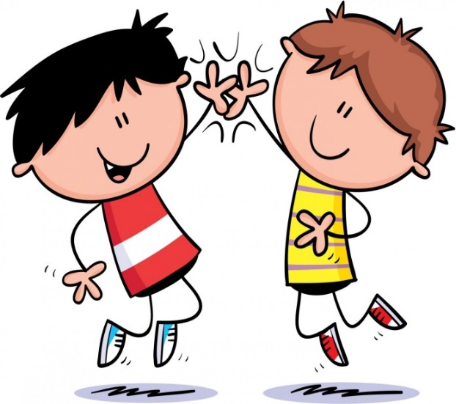
What Does Kindness Look Like?
Working as a team
Sharing
Standing up for someone being teased
Letting someone borrow school supplies
Giving a high five, hug, or smile
Teaching someone how to do something
Helping someone who is hurt
Inviting someone to join you at lunch
Cheering someone up who is having a bad day
Holding the door for someone
Notes:
Say, “Some other things people can do to show kindness are,” and read any ideas that weren’t shared by students.

Slide 12
What does being kind
sound like?
Notes:
- Read the question & explain that you want them to think of things people can say to show kindness (give them examples if needed). The Kagan structures RoundRobin, Talking Chips or StandUp, HandUp, PairUp could be used.
- Ask for students to share an idea or one they heard

Slide 13

What Does Kindness Sound Like?
“Let me give you a hand with that.”
“Would you like to play with us?”
“Good try. You’ll get it next time.”
“You can go first.”
“Are you OK?”
“That was an awesome idea!”
“Good luck.”
“I know you can do it!”
“Do you want to be my partner?”
“You can borrow my crayons.”
“Is there anything I can do to help?”
“You did an amazing job!”
Notes:
Say, “Some other things you can say to show kindness are,” and read any ideas that weren’t shared by students.
You may also want to discuss what unkindness sounds like.

Slide 14

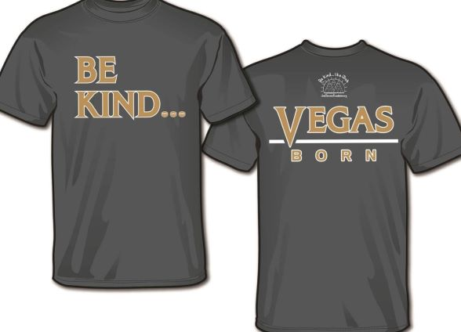
BE KIND T-SHIRTS
You can buy a shirt and wear it on Mondays to
help spread the Be Kind message at school, at home and in our neighborhoods! This year’s Be Kind shirt…
$12
Notes:
Read the slide. Say, “Shirts will are available to order for $12. Even if you’re not able to buy a shirt, you can still spread the Be Kind message by being kind to everyone, everywhere, every day.”

Slide 15

SUPER
CUBS…

Slide 16
ARE
SUPER
KIND!

